Slide 1
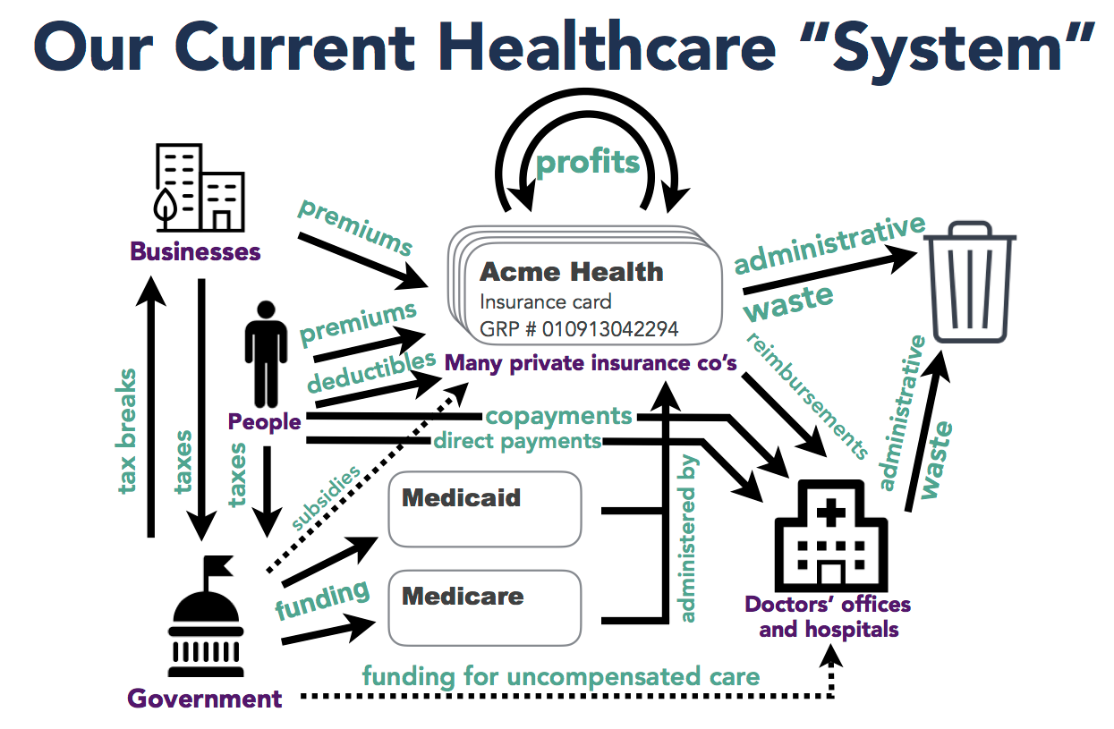
This is where I work
Credit: Daniel Neghassi, MD. dneghassi.com
Notes:
I wanted to start off by showing you where I work. (Or this is where I get my healthcare)
[advance]
I work – in fact we all work – in a horrible mess of a healthcare system.
This is a simplification, if you can believe it, representing how payment and coverage happens and doesn't happen under the Affordable Care Act, which for all the good it has done, it didn't change the fundamentals of how this system is broken.
About half of Americans get their insurance through their employer or their family’s employer.
Others buy insurance directly from the market place.
Elderly and disabled patients get Medicare
Low income folks get Medicaid
Then there are Children’s Health Insurance Program, the V.A. and I.H.S. not shown here.
The uninsured either pay out of pocket, or find charity care, or delay going to the doctor.
Front and center here are for-profit insurance companies which administer many of the public programs.
The problem here is this system is
⁃ PROFIT-DRIVEN - are we going to do the thing that is better for the patient’s health or for our bottom line? Profit tends to win out.
⁃ WASTEFUL - all the billing and denials and appeals leads to unnecessary cost.
⁃ FRAGMENTED - There are so many gaps to fall through in this system.
- MULTI-TIERED - depending on your insurance, you will find you can access care at some places and not at others. in other words, it is SEPARATE AND UNEQUAL, it is UNJUST.
- EXPENSIVE - People who earn income fund their own insurance plan - they have to pay premiums, and deductibles and copayments – and all of those costs are increasing fast; plus they fund public programs.

Slide 2
Credit: Daniel Neghassi, MD. dneghassi.com
Notes:
There is a better way.

Slide 3
Credit: Daniel Neghassi, MD. dneghassi.com

Slide 4
Credit: Daniel Neghassi, MD. dneghassi.com
Notes:
95% of households will pay less for insurance then they pay now.

Slide 5
Credit: Daniel Neghassi, MD. dneghassi.com

Slide 6
Credit: Daniel Neghassi, MD. dneghassi.com

